Slide 1
Lab 5
Foundations for Statistical Inference – Confidence Intervals

Slide 2
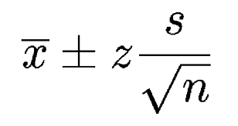
Confidence Intervals
“We are XX% confident that the population mean lies between [lower bound] and [upper bound]”
XX% Confidence: We would expect XX% of random samples of size n = __ taken from this population will yield confidence intervals that capture the true mean

Slide 3
Hints…
Don’t forget to set a seed!
Exercise 1 – You need to make a histogram!
Exercise 4 – Don’t forget to mention sample size!
Exercise 6 – Consider how many teams there are in the class… Would this affect the proportion of intervals capturing the mean?

